Slide 1
WAN Connections
Understanding WAN Technologies

Slide 2
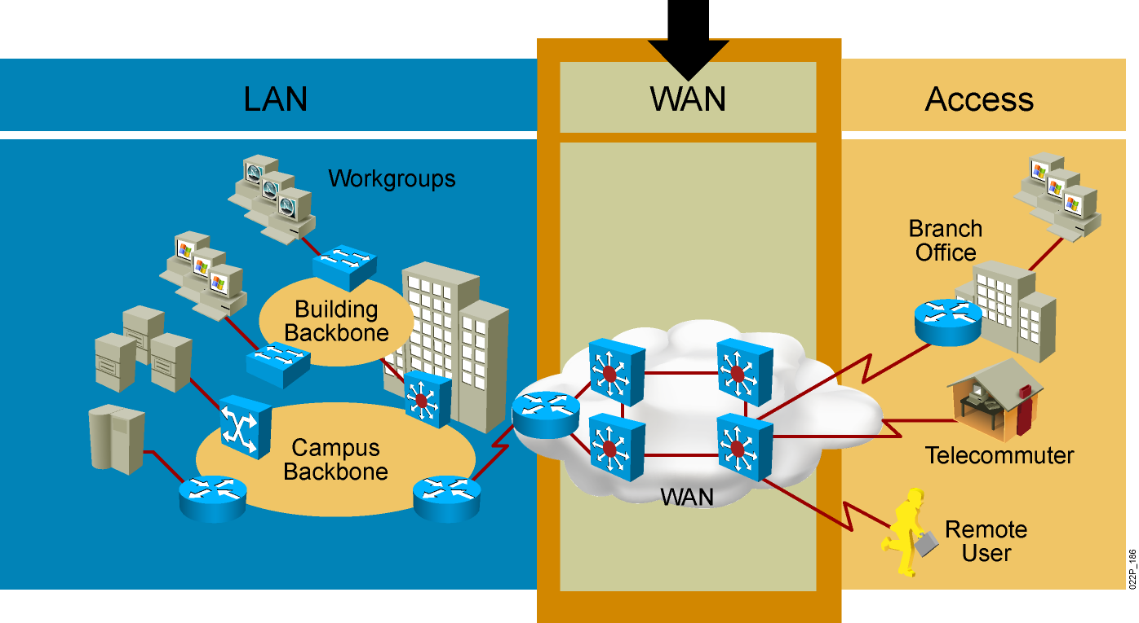
Wide-Area Network

Slide 3
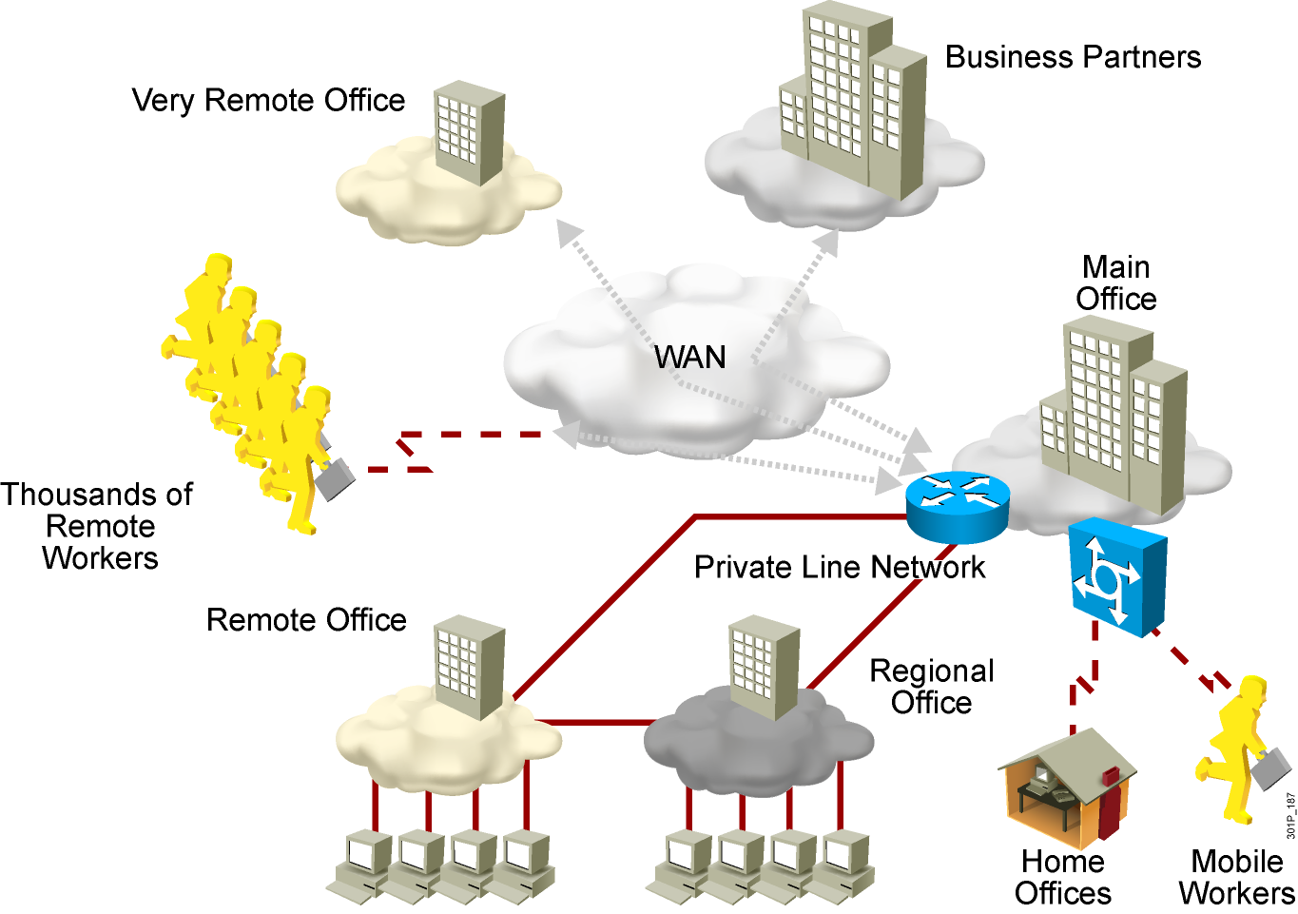
Need for WANs

Slide 4
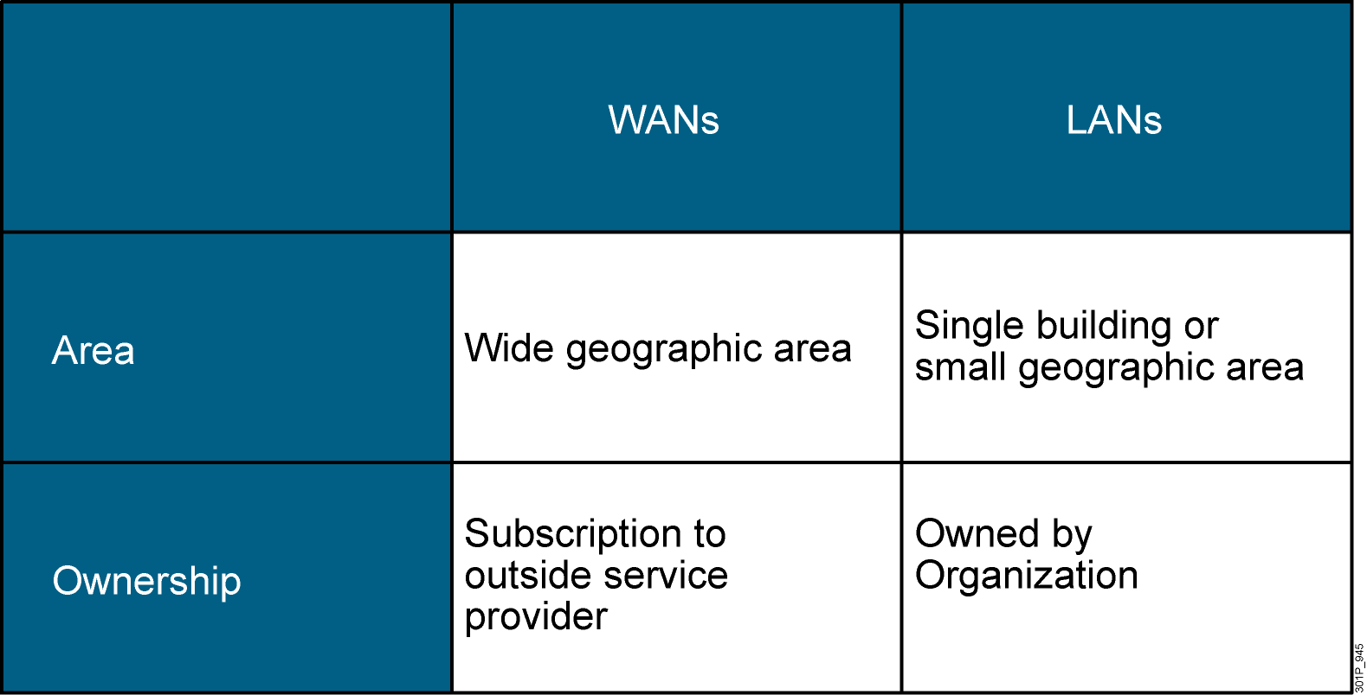
WANs vs. LANs

Slide 5
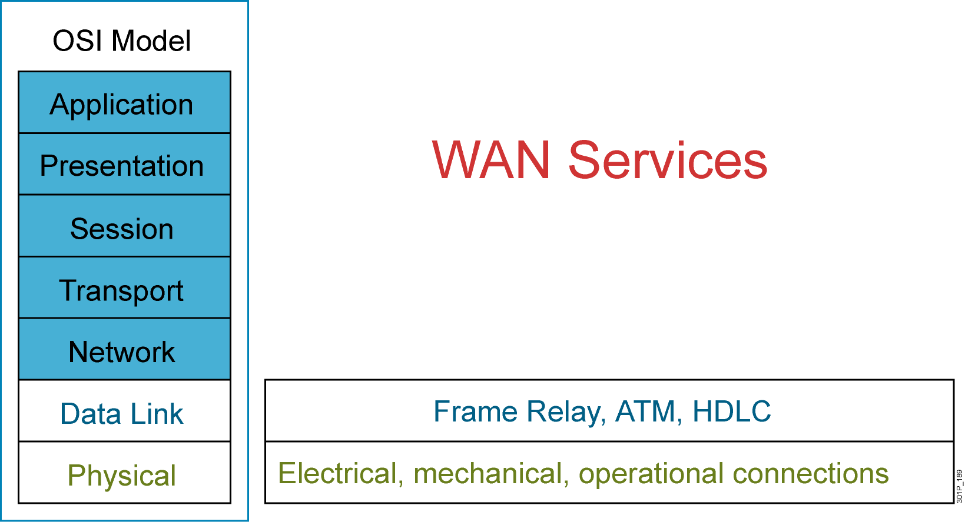
WAN Access and the OSI Reference Model

Slide 6
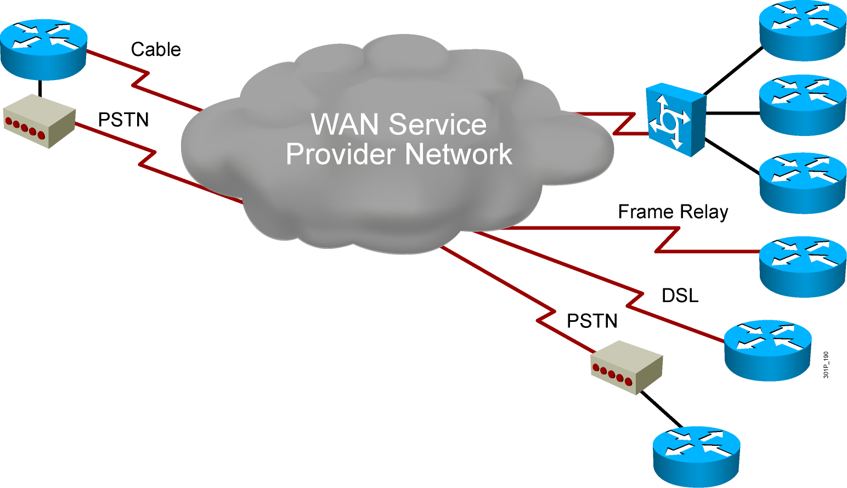
WAN Devices
  Routers
  Terminal servers
  Modems
  DSU/CSU
  WAN networking devices
    ATM switches
    Frame Relay switches
    PSTN

Slide 7
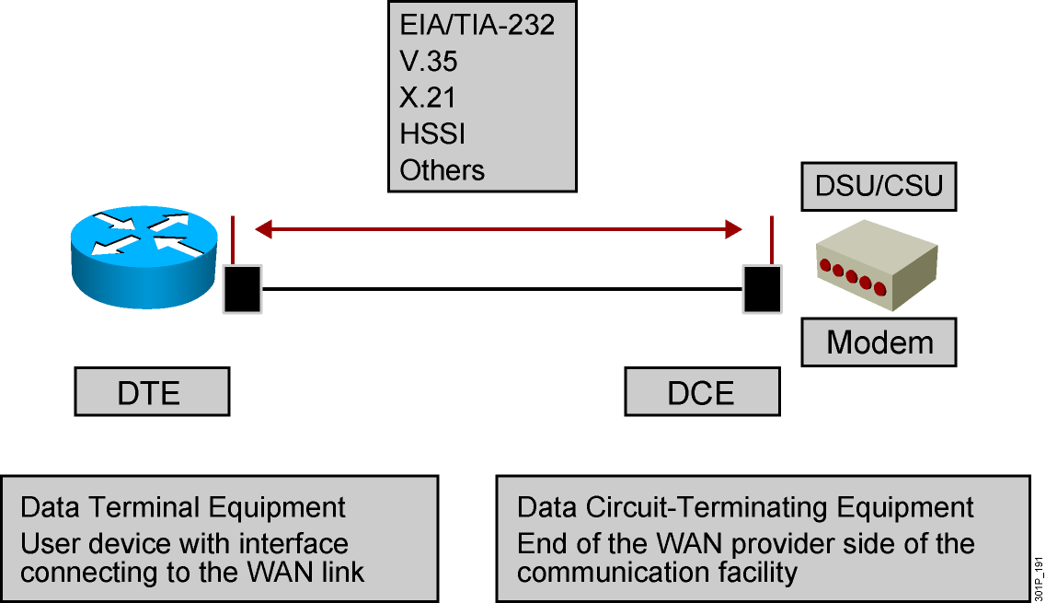
Physical Layer: WANs

Slide 8
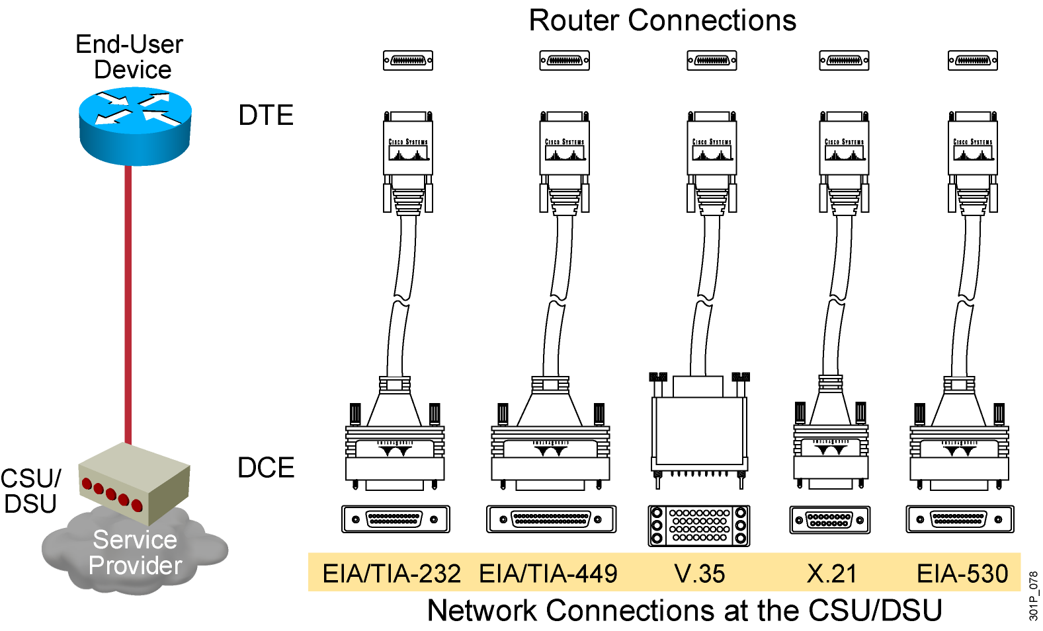
Serial Point-to-Point Connections
Notes:
Purpose: This section describes the various serial standards that support leased-line connections.
Emphasize: The same 60-pin end that attaches to a Cisco device supports all the standards illustrated.
Note: Data switching equipment (DSE) is an additional term sometimes used to describe the switch components that appear inside the cloud. The DSE adds and removes channels assigned inside the WAN. The DSE connects traffic from various sources to their final destinations through other switches.
Transition: The next layer in the stack is Layer 2, the data link layer.

Slide 9
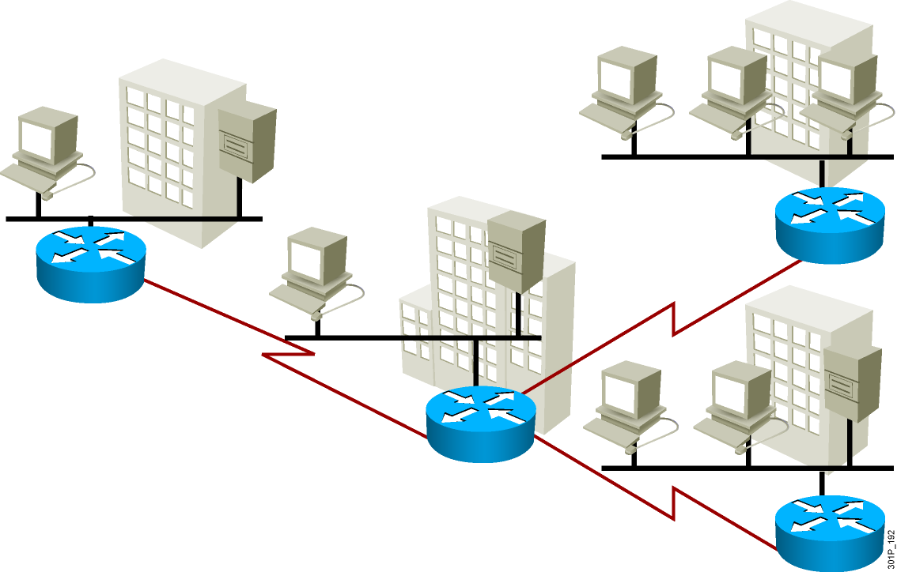
WAN—Multiple LANs

Slide 10
WAN Data-Link Protocols
  HDLC
  PPP
  Frame Relay (LAPF)
  ATM

Slide 11
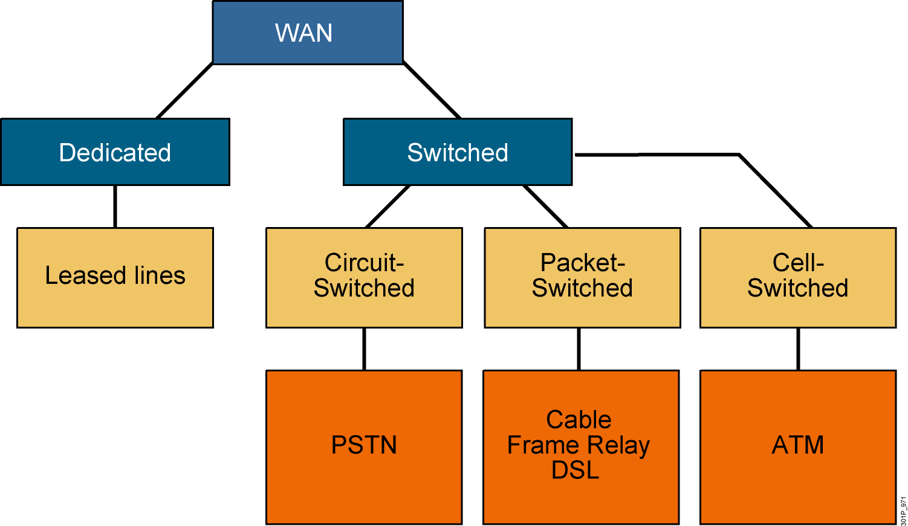
WAN Link Options

Slide 12
Summary
  There are three major characteristics of a WAN: connection of devices that are separated by wide geographical distances; use of the services of carriers, such as telephone companies, cable companies, satellite systems, and network providers; and use of serial connections of various types to access bandwidth over large geographic areas.
  Many businesses and homes require communication among remote users, including Communication between users in remote company locations, data-sharing among different organizations, access to corporate information by traveling workers, and access to the Internet.

Slide 13
Summary (Cont.)
  LANs connect computers, peripherals, and other devices in a single building or other small geographic area; WANs transmit data across broad geographic distances.
  A company, organization, or individual must subscribe to an outside WAN service provider to use WAN network services, while LANs are typically owned by the company, organization, or individual that uses them.
  WAN access functions in relation to the OSI reference model; the WAN function focuses primarily on Layer 1 and Layer 2.

Slide 14
Summary (Cont.)
  The major types of devices used for WAN access environments include routers, communication servers, modems (DSU/CSUs), and other networking devices such as Frame Relay and PSTN switches.
  Routers have both LAN and WAN interfaces, and while a router is used to segment LANs, it is also used as the WAN connection device.
  The data link layer-based protocols define how data is encapsulated for transmission toward remote sites in a WAN environment and the mechanisms for transferring the resulting frames. A variety of technologies, such as ISDN, Frame Relay, or ATM are used.

